Slide 1
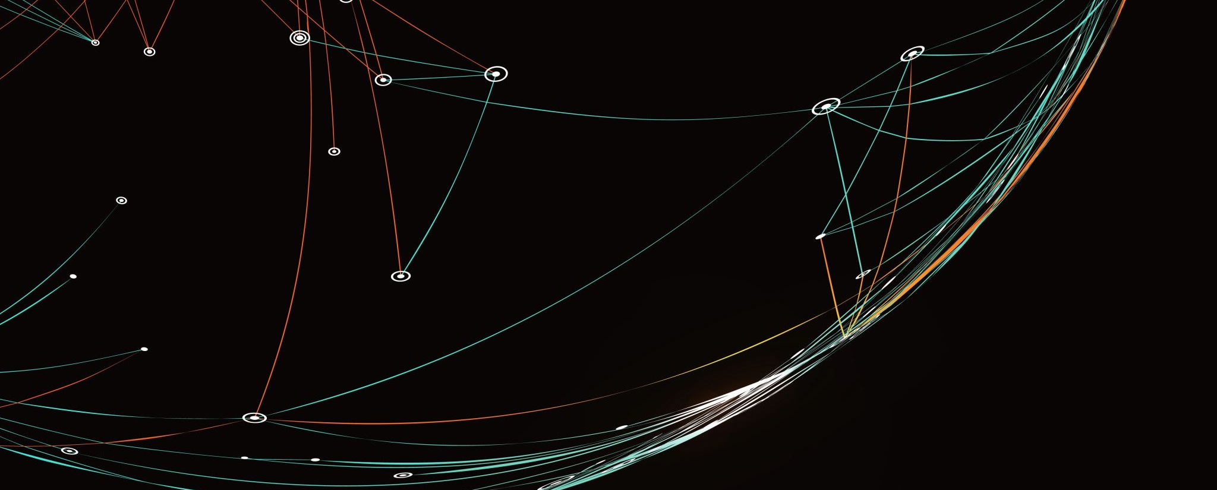
Lab Meeting

Slide 2
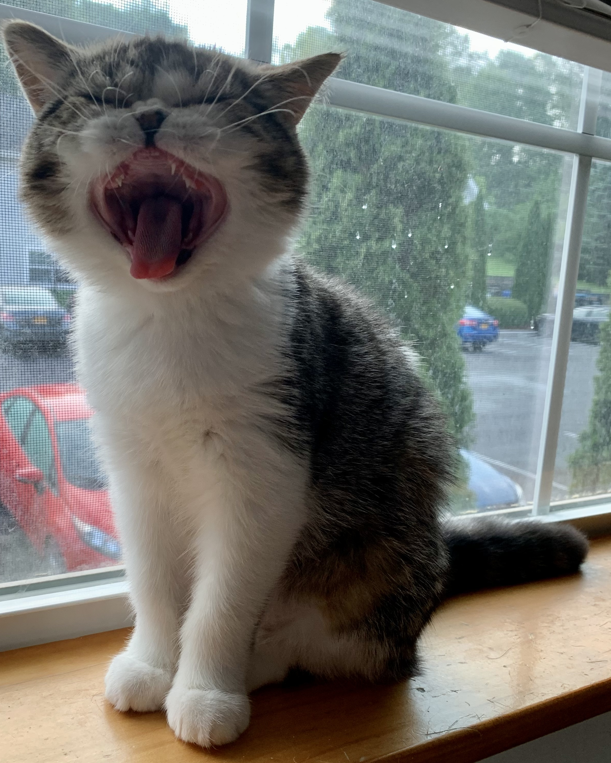
Overview of Projects
ICP4 Cloning
CMV-RFP-ICP4 → native_promoter-RFP-ICP4
Western Blots & Immunofluorescence
Impact of various epigenetic inhibitors on HSV1 infection
CUT&RUN
Optimize for use in viral infections
MiND-seq & ATAC-seq
Compare cellular and viral chromatin
Phylogenetics
Characterize orthologs of VP16, ICP0, and ICP4 in various herpesviruses

Slide 3

ATAC-seq & MiND-seq

Slide 4
Two assays to survey chromatin accessibility
assay for transposase-accessible chromatin followed by sequencing (ATAC-seq)
Specifically identifies open regions of chromatin
Fast (<1 day), requires only ~50,000 cells

Slide 5
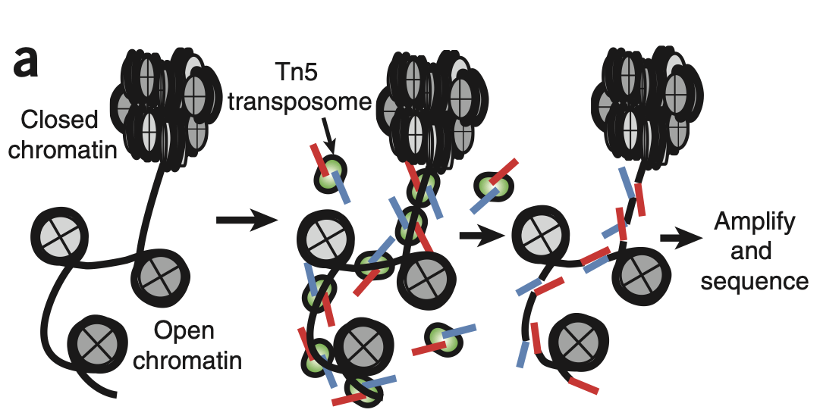
Buenrostro et al, 2013

Slide 6
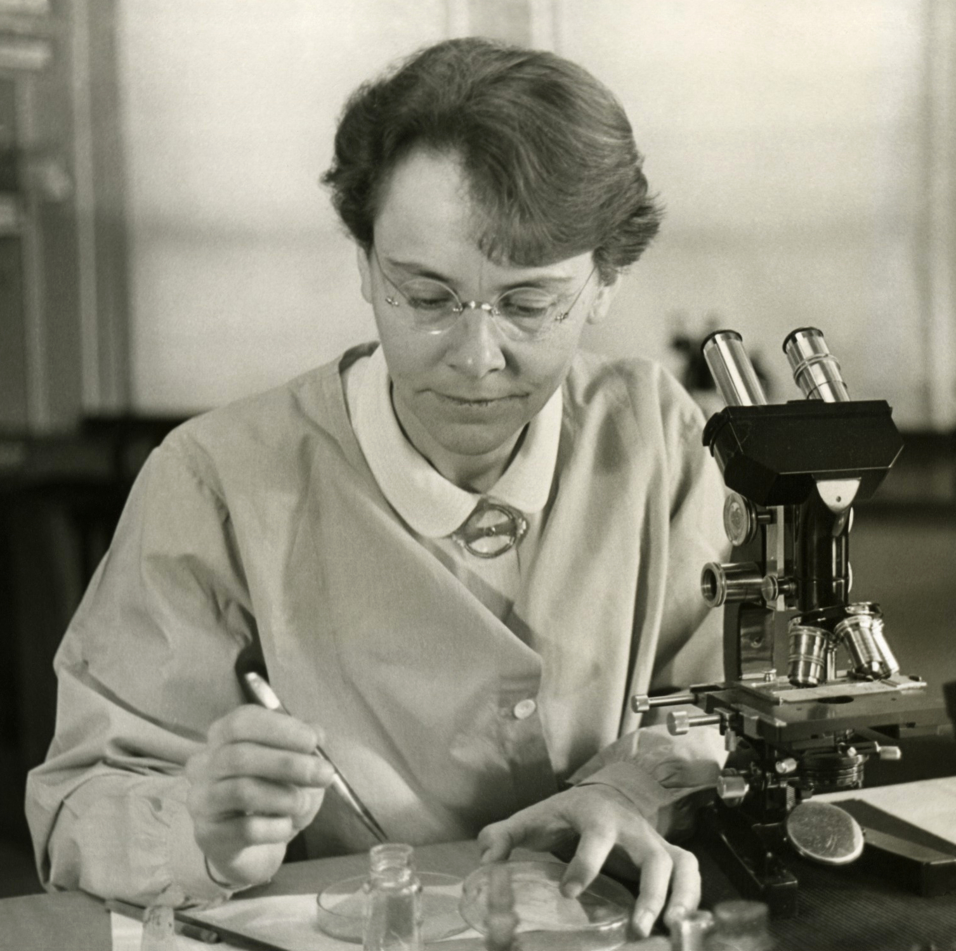
Tn5 Transposase
Transposons are “jumping genes” that can integrate themselves into genomes
First discovered by Barbara McClintock in Z. mays
Somewhat similar to viruses (some speculate an evolutionary relationship between the two)
“junk DNA” that isn’t really junk
Overall pretty cool

Slide 7
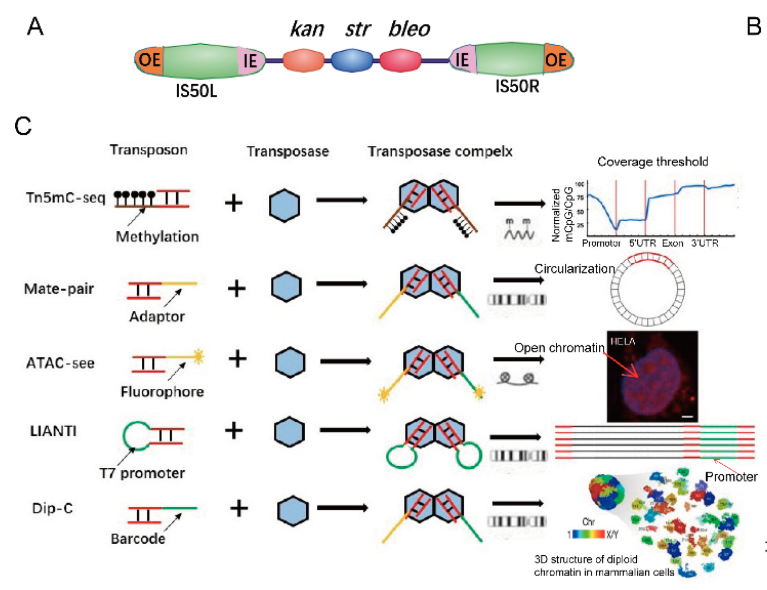
Tn5 Transposase
First discovered in E. cdi
used in a variety of genomic assays

Slide 8
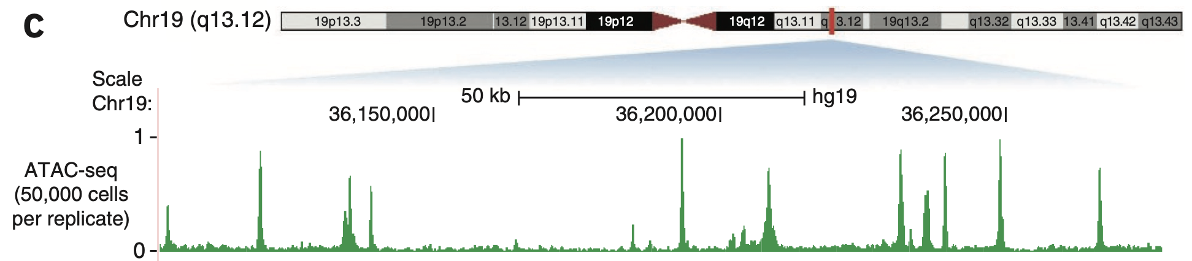
Buenrostro et al, 2013

Slide 9
Single- versus paired-end sequencing

Slide 10
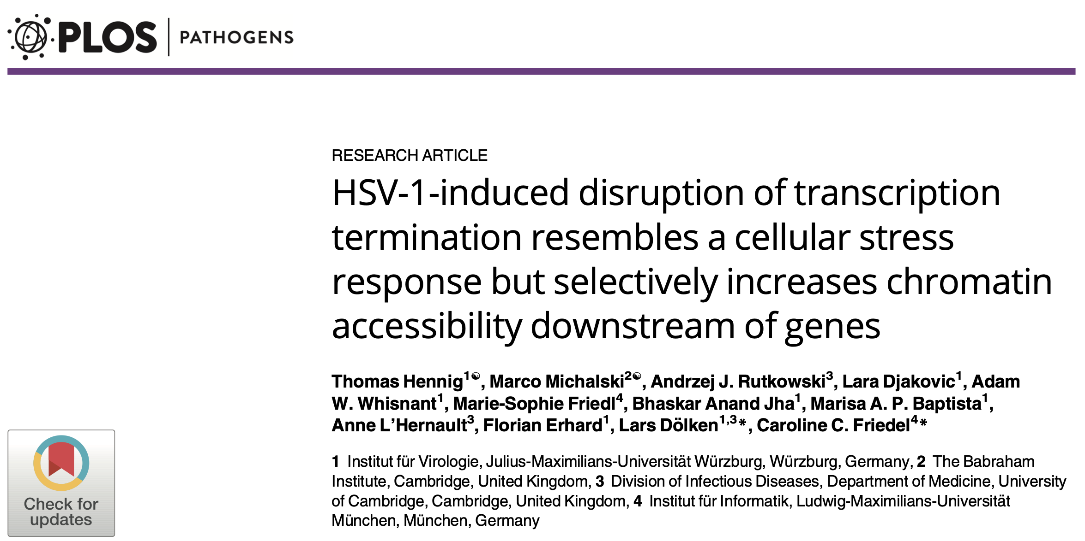

Slide 11
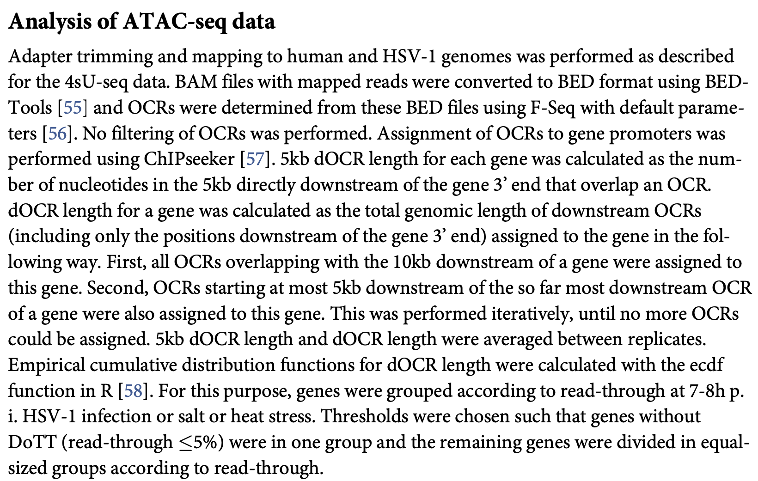

Slide 12
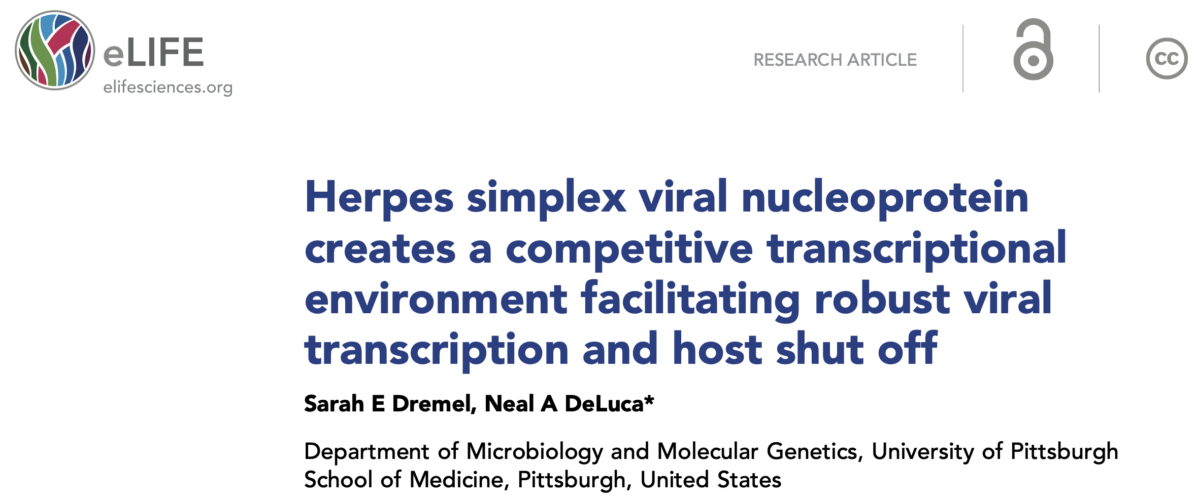

Slide 13
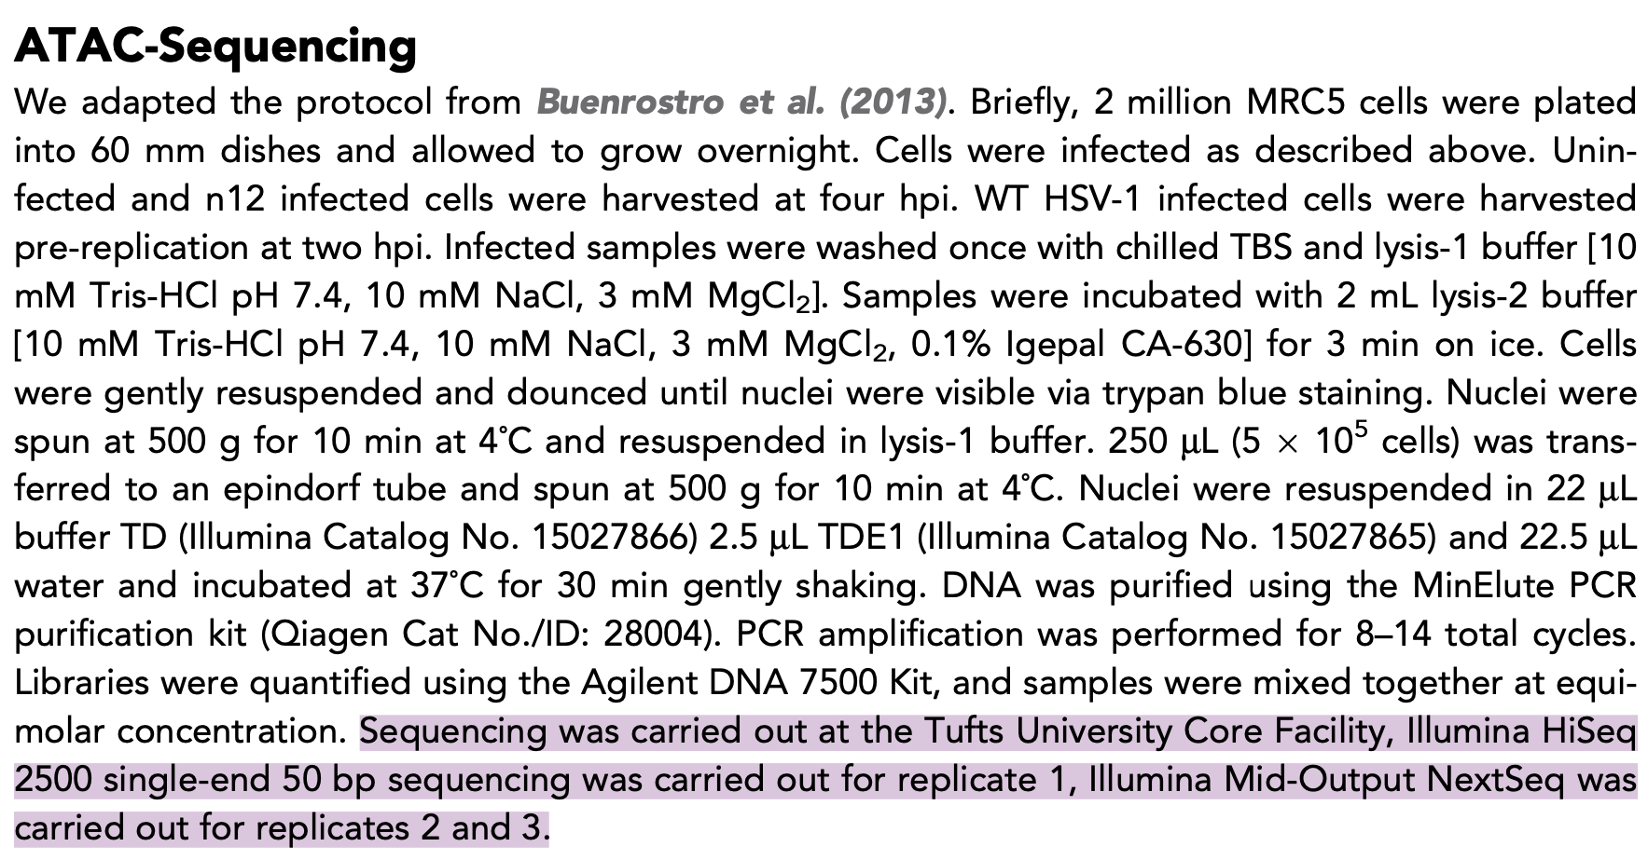

Slide 14
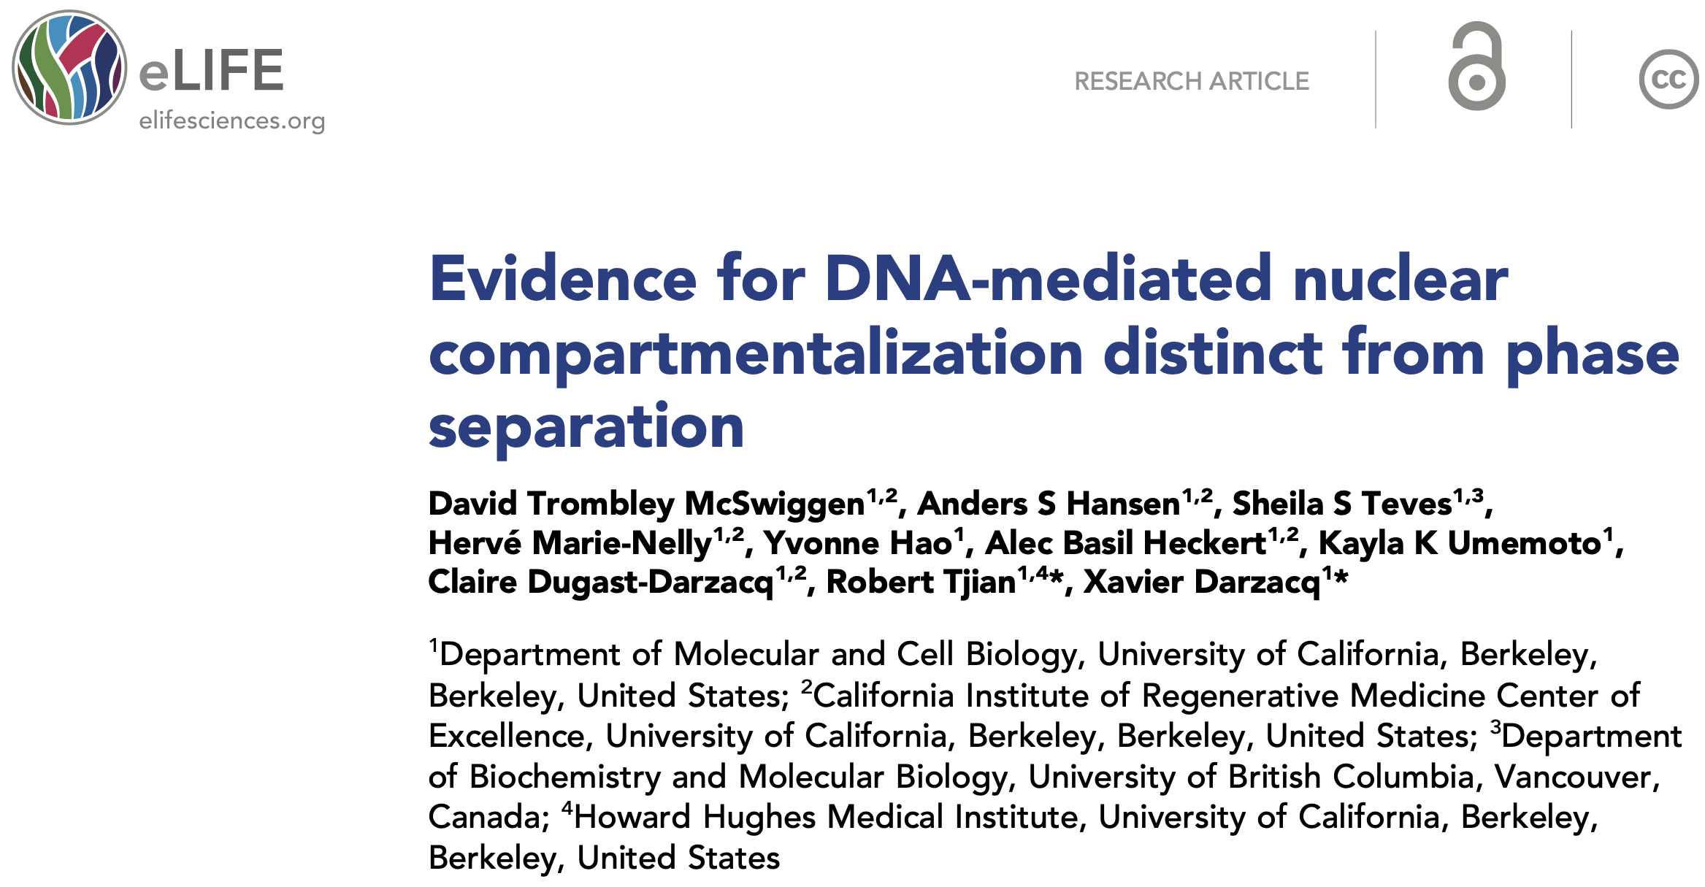

Slide 15
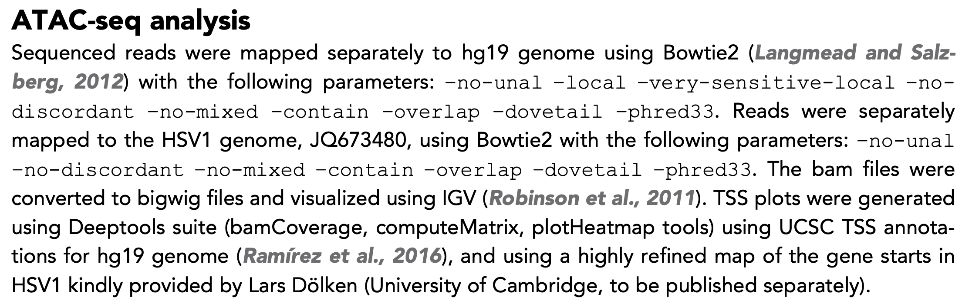

Slide 16
Overview of ATAC-seq Datasets
Publication | Virus | MOI | Time Points | Cell Line | Misc.
Hennig et al, 2018 | Strain 17 | 10, 15 min | 1, 2, 4, 6, and 8 hpi | HFF
McSwiggen et al, 2019 | KOS | 0.01? 15 min | 2, 4, and 6 hpi and 6hpi with PAA | U2OS
Dremel & DeLuca, 2019 | Strain 17 n12 | 10 PFU 1 hr | 2hpi (WT) 4hpi (n12 & mock) | MRC5 | PE for 1st rep only

Slide 17
Mapped simultaneously to hg19 & JQ673480
Bowtie2 with no additional filters
Remove mitochondrial, blacklisted regions, and duplicated reads
Split into cellular and viral files
homemade histograms & Gviz
Saddoris
Hennig
Ambiguous mapping
No additional filtering
Bamtobed
IVG visualization
Mapped to hg19 and JQ673480 separately
-no-unal -local -very-sensitive-local -no-discordant -no-mixed -contain -overlap -dovetail -phred33
bamCoverage
IVG visualization
McSwiggen
Mapped to hg38, unmapped reads mapped to KT899744
–no-unal –local –very-sensitive-local –nodiscordant –no-mixed –contain –overlap –dovetail –phred33
CollectInsertSizeMetrics
bamCoverage
IVG visualization
Dremel

Slide 18
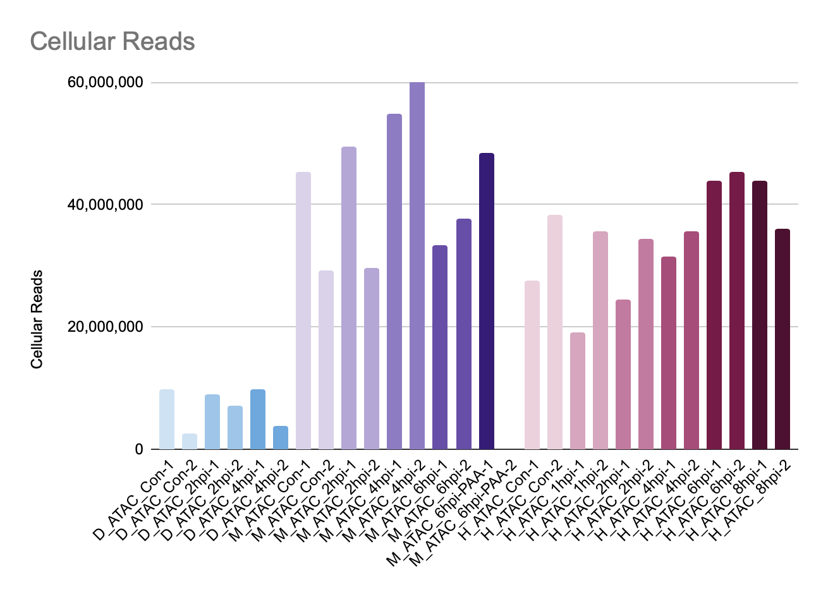

Slide 19
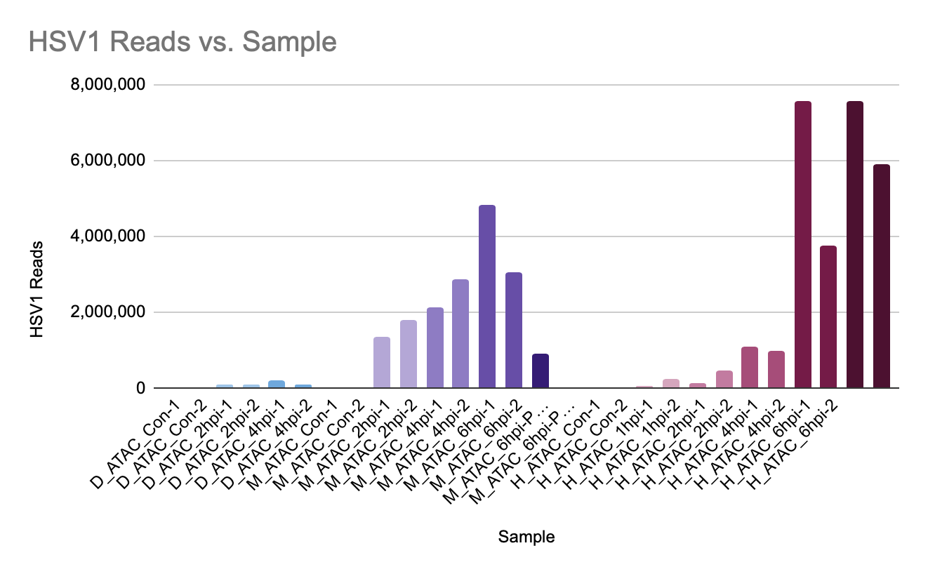

Slide 20
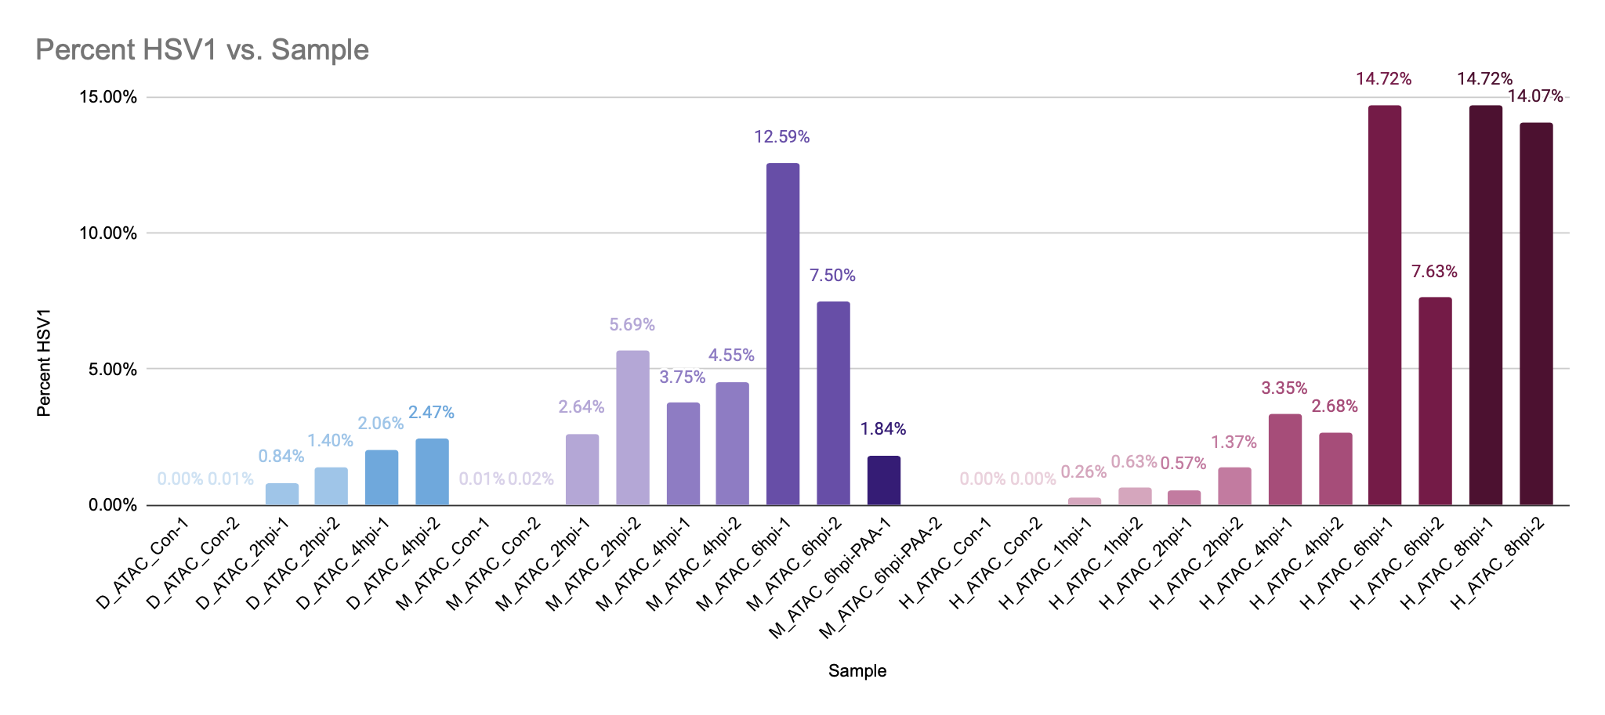

Slide 21
Single end sequencing
paired end sequencing

Slide 22
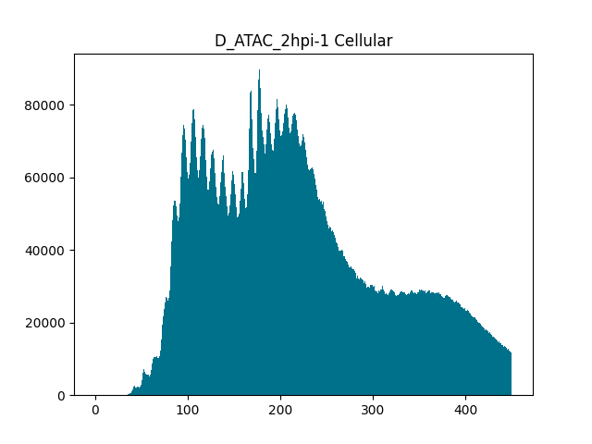
DataSet_DataType_Treatment_Rep
No. of Reads
Fragment Length
(length between Tn5 insertions)

Slide 24
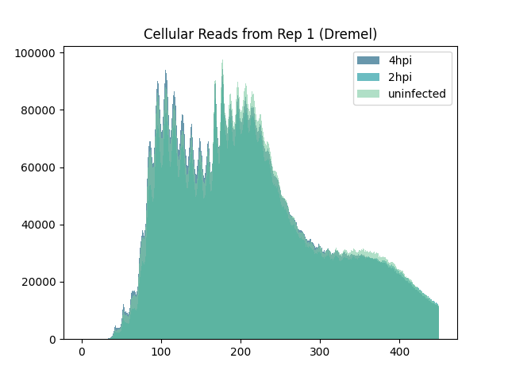
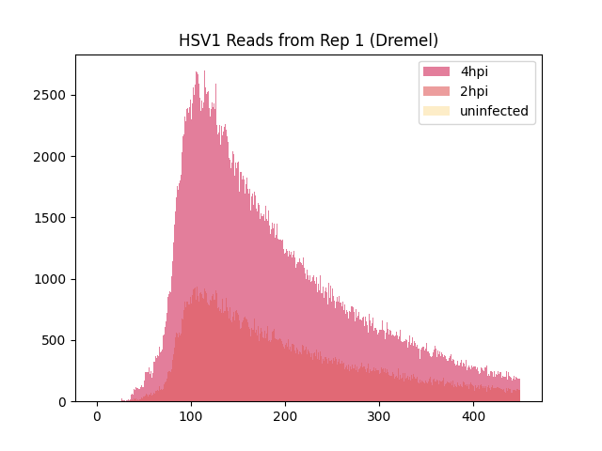

Slide 25
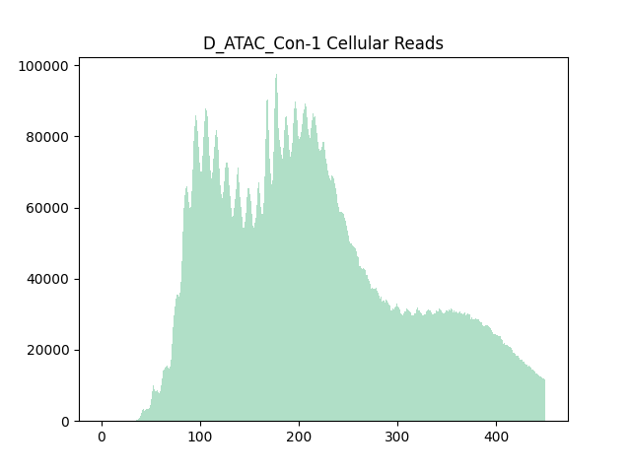
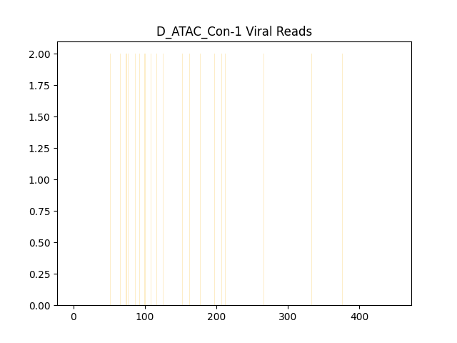

Slide 26
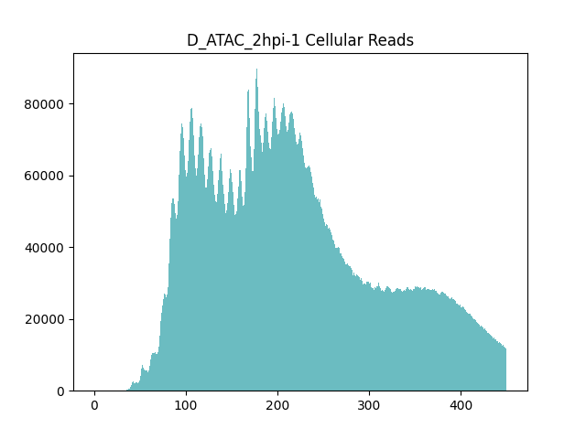
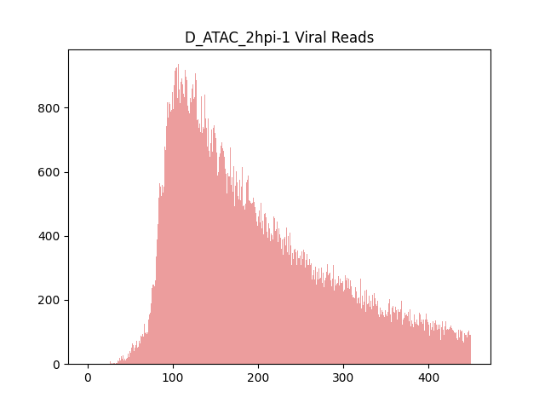

Slide 27
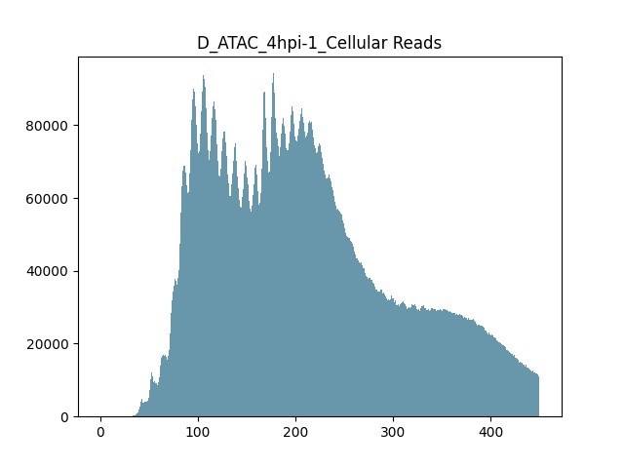
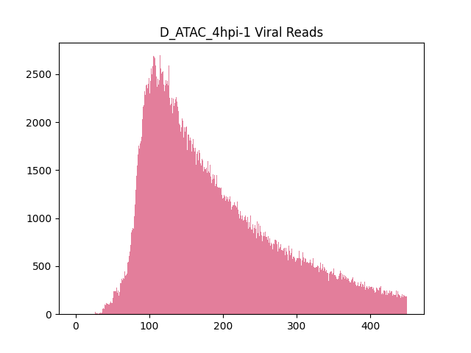
n12 (ICP4 mutant)
Cellular genome appears to gain a bit of accessibility—due to lack of ICP4?

Slide 28
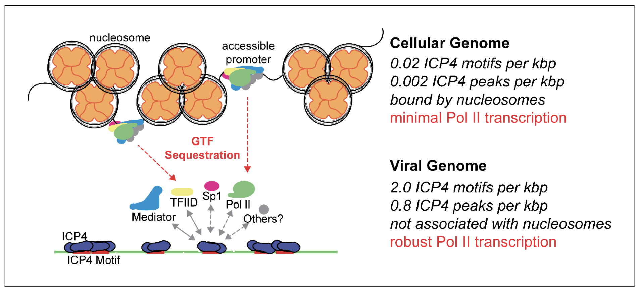

Slide 29
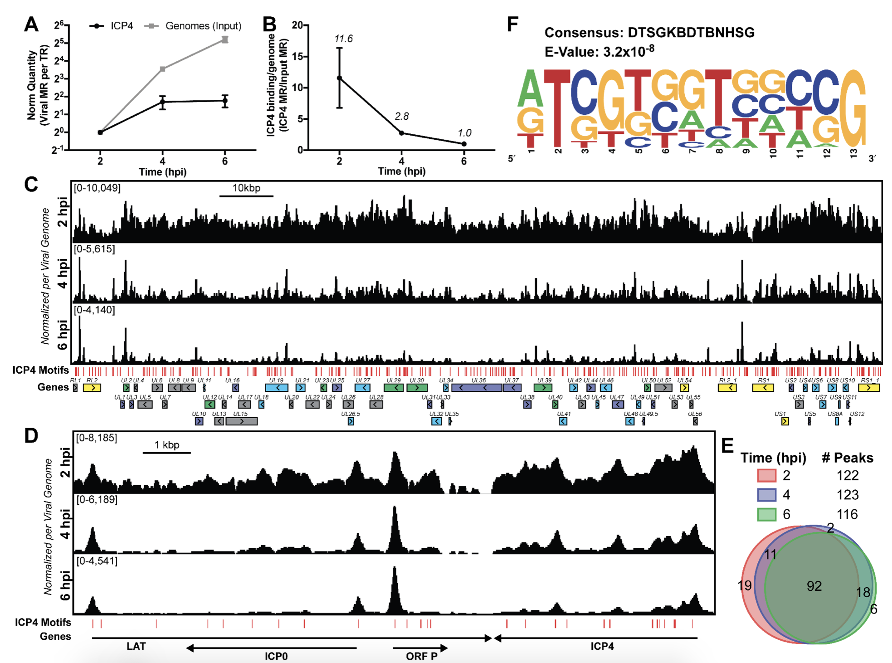

Slide 30
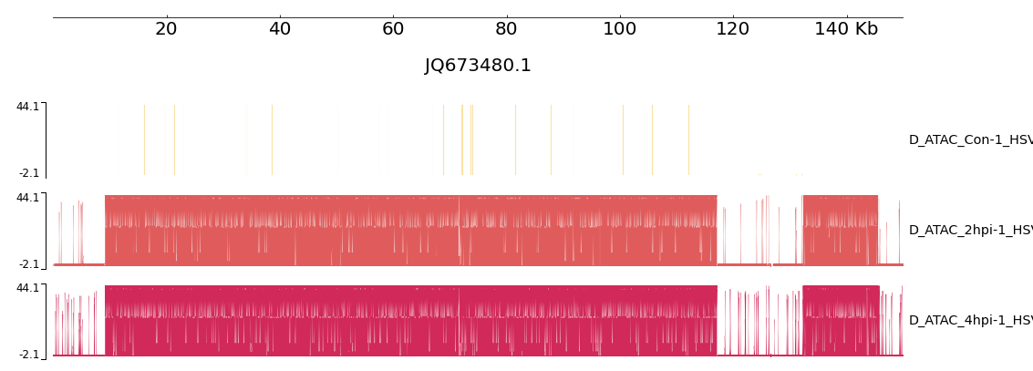

Slide 32
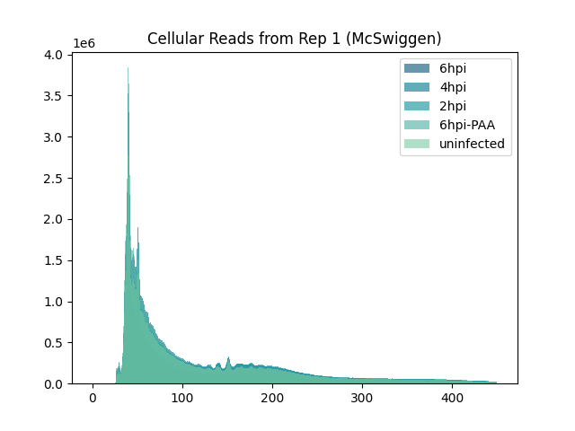
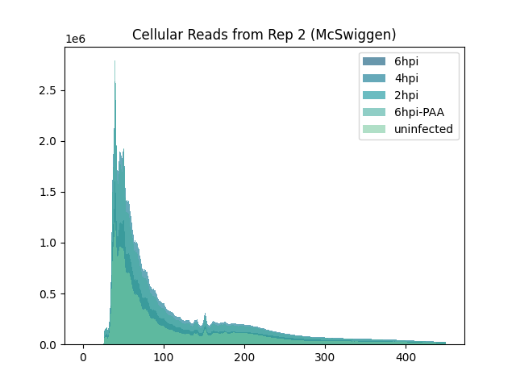

Slide 33
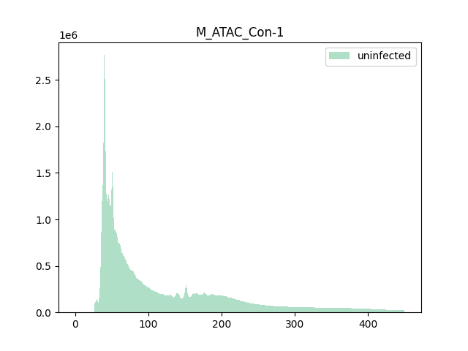
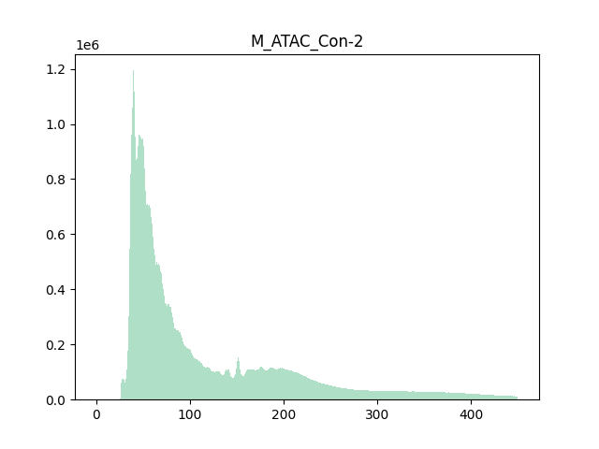

Slide 34
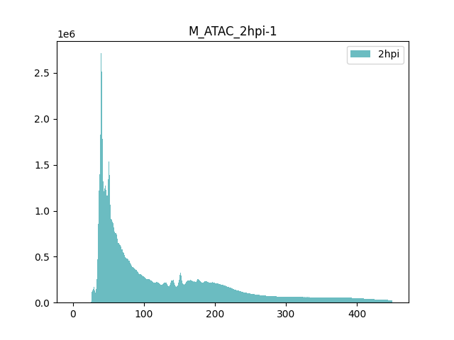

Slide 35
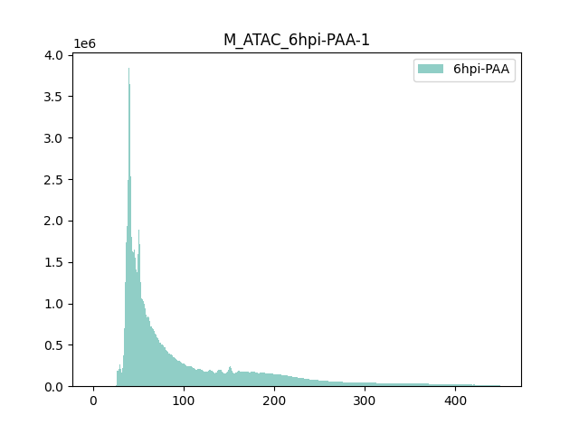
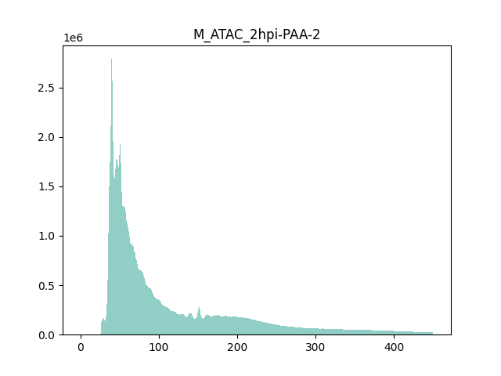

Slide 36
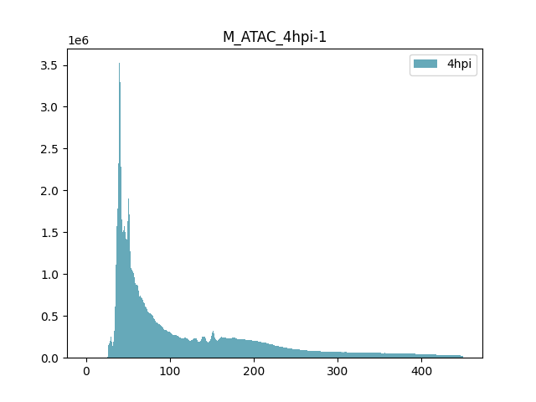
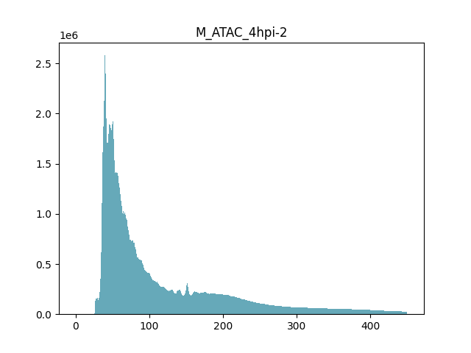

Slide 37



Slide 38
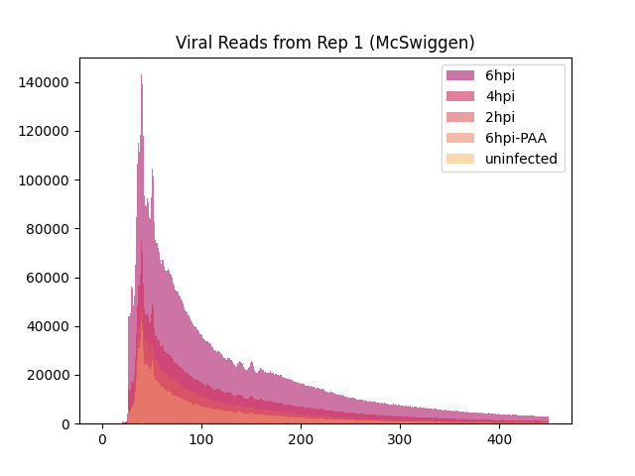

Slide 39
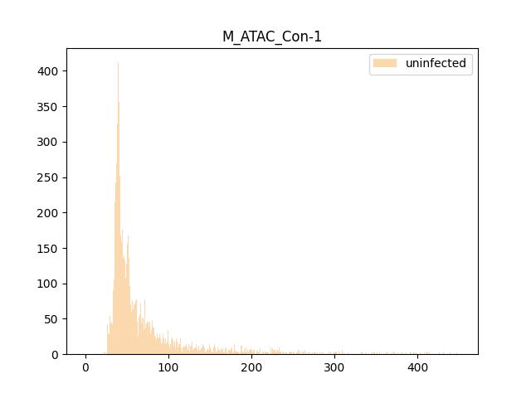
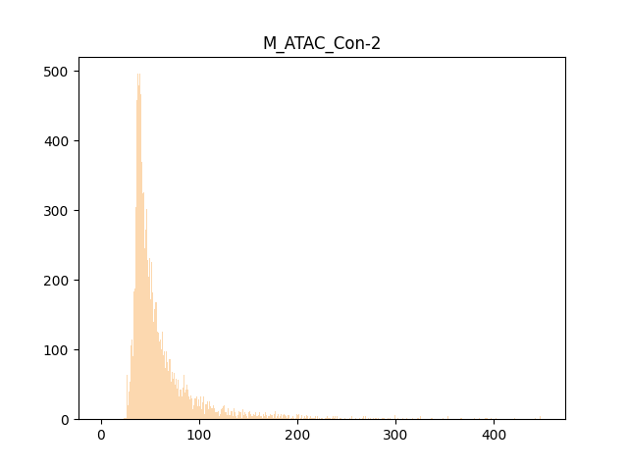

Slide 40
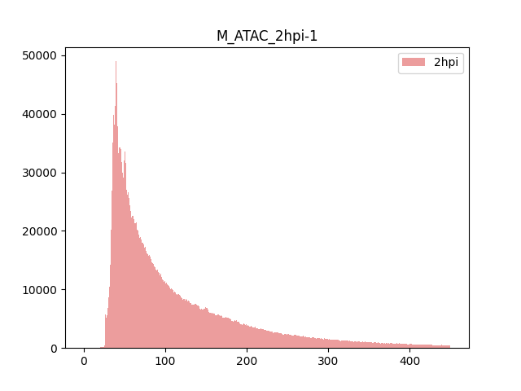

Slide 41
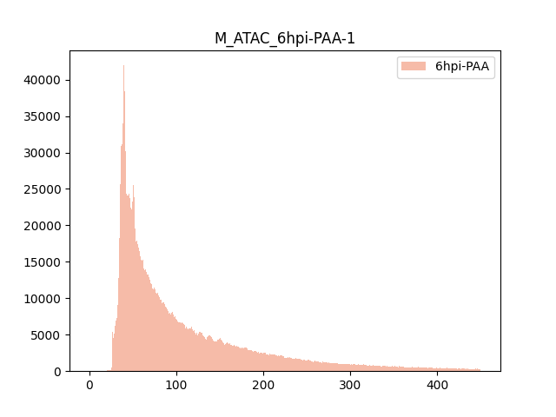
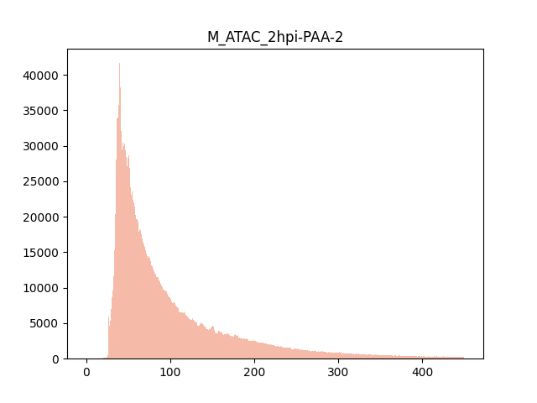

Slide 42

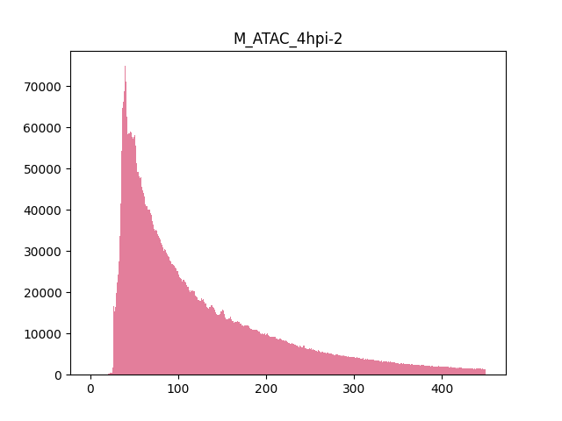

Slide 43
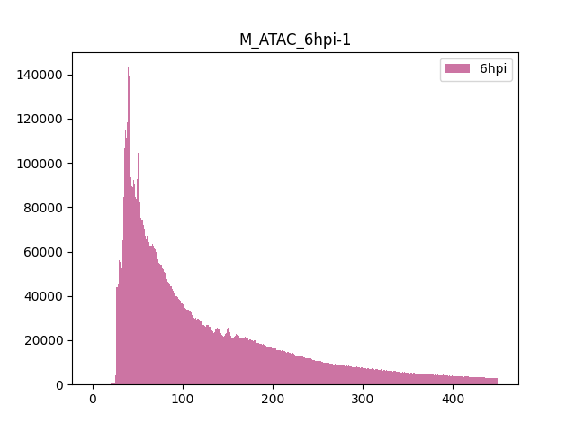
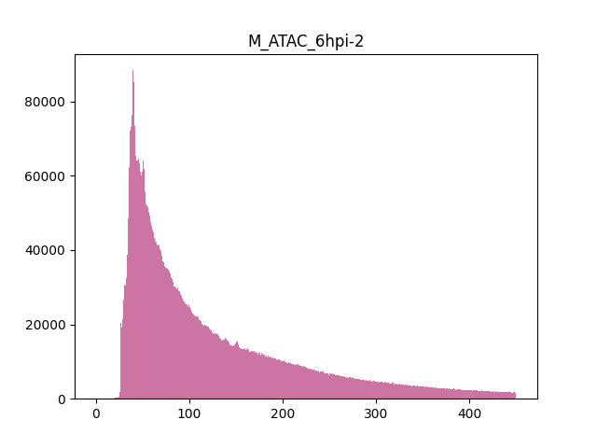

Slide 45
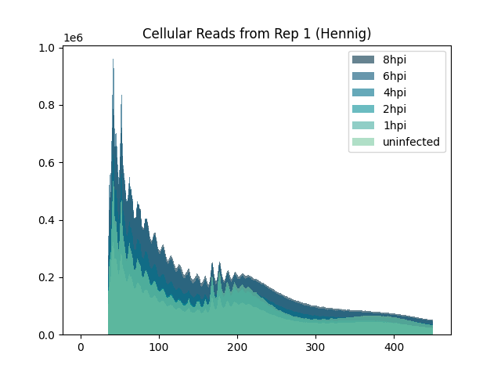
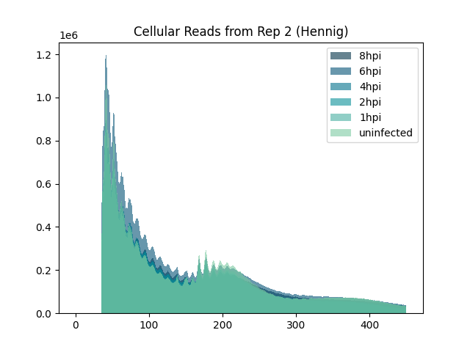

Slide 46
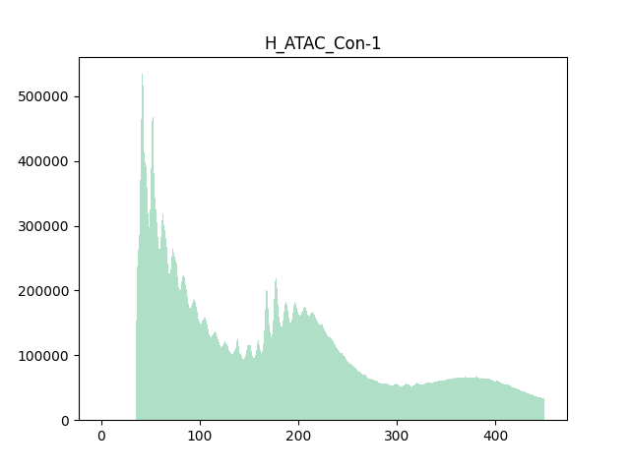
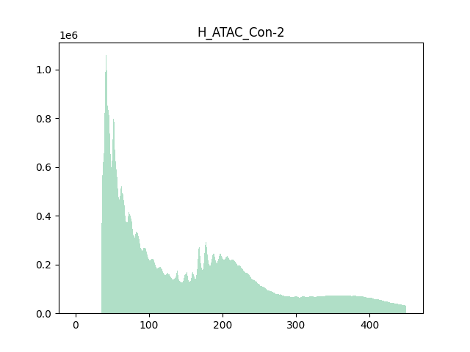

Slide 47
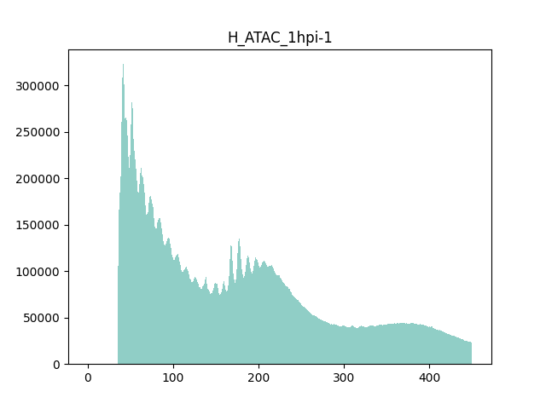


Slide 48



Slide 49



Slide 50



Slide 51



Slide 52



Slide 53



Slide 54



Slide 55



Slide 56



Slide 57



Slide 58



Slide 59
Comparison of ATAC-seq Datasets
HSV1 fragment distributions remain consistent throughout the different datasets
No change in distribution patterns throughout lytic infection cycle
(would be interesting to see how this pattern changes as the virus transition to latent infection)
Cellular fragment distribution patterns vary greatly between datasets, but are consistent within datasets
Very little if any changes in fragment size distribution throughout infection

Slide 60
Two assays to survey chromatin accessibility
assay for transposase-accessible chromatin followed by sequencing (ATAC-seq)
Specifically identifies open regions of chromatin
Fast (<1 day), requires only ~50,000 cells
micrococcal nuclease digestion followed by sequencing (MiND-seq)
Serial digestion produces fractions to be sequenced
Provides more detailed gradient of chromatin accessibility

Slide 61


Slide 62
Genic vs Non-Genic
Are reads from genic versus non-genic regions fractionated differently?
Gene Expression
Does read distribution relate to gene expression level?
Epigenetics
Do regions with shared epigenetic signatures fractionate together?
Validation
Do ATAC-seq peaks fractionate as expected?

Slide 63
Phylogenetic Analysis
Evolutionary insight into Herpesviridae diseases

Slide 64

What is the same? What is different?

Slide 65
HSV1
HHV1
~50% seroprevalence
HSV2
HHV2
~11% seroprevalence
VZV
HHV3
~90% children vaccinated
simplexvirus
simplexivurs
varicellovirus
Ocular keratitis, oral & genital sores, encephalitis
Chicken pox & shingles
Genital sores

Slide 66
HCMV
HHV5
~83% seroprevalence (~99% in developing countries)
HHV6 (A/B)
HHV6
HHV7
HHV7
Seroconversion ~24 months
~99% seroprevalence
complicates organ transplantation
Handful of integration events (horizontal transfer)
Seroconversion ~13 months
~99% seroprevalence (?)
Rarely pathogenic in immuno-competent hosts
Rarely pathogenic in immuno-competent hosts
Largest genome of the HHVs
Roseolovirus
Roseolovirus
Congenital infection affects 1-3% of infants

Slide 67
EBV
HHV4
Oncogenic!
KSHV
HHV8
Oncogenic!
Seroprevalence varies widely
~10% Africans
~33% MSM
~17% IVDU
KS, primary effusion lymphomas, & multicentric Castleman’s disease
Mononucleosis, Burkitt’s lymphoma, Hodgkin’s disease
~90% seroprevalence
Rhadinovirus
Lymphocrytovirus

Slide 68


Slide 69
Proposed Workflow for Preliminary Analysis
Gather Genomes
Roughly equal number of species from each subfamily
Analyze Species Individually
HHV1, HHV3, HHV4, and HHV5 all have a lot of sequenced genomes
How conserved are VP16, ICP0, and ICP4 (homologs) within each species?
Analyze Across Species
Which regions are conserved among all (or most) herpesviruses, which are conserved among alpha, etc.?

Slide 70
HSV1 Reference
100%
Percent Conserved Among Species
N terminus
C terminus

Slide 71
Extra Information

Slide 72
Bowtie2
-no-unal Suppress SAM records for reads that failed to align
-local Bowtie2 performs local read alignment (may be better to use local for cellular reads and global for viral reads)
-very-sensitive-local
-no-discordant does not allow mapping of discordant pairs, which is a pair where both mates align uniquely, but that does not satisfy the paired-end constraints
-no-mixed disables Bowtie2 from looking for mapping of individual mates
-contain if one mate alignment contains the other, consider that to be non-concordant
-no-overlap If one mate alignment overlaps the other at all, consider that to be non-concordant.
-dovetail If the mates "dovetail", that is if one mate alignment extends past the beginning of the other such that the wrong mate begins upstream, consider that to be concordant
-phred33 Input qualities are ASCII chars equal to the Phred quality plus 33

